Slide 1


Event Driven .NET Apps with Azure Functions
A Beginners guide to building event driven serverless apps using event driven architecture
Mandar Dharmadhikari

Slide 2




Who am I?
mandardhikari
@theabodeofcode
Technical Consultant at Chamonix IT Consulting Pty Ltd, Adelaide, South Australia
Integration and AI enthusiast
TechNet Wiki Ninja and Author
Blogger at https://www.theabodeofcode.com
Die Hard Metallica, Dragon Ball and GOT fan
Budding cook
https://au.linkedin.com/in/mandar-dharmadhikari

Slide 3
Takeaways from the Session
What is event driven programming
Azure Options for Event Driven Programming
Demo
Reading Resources

Slide 4
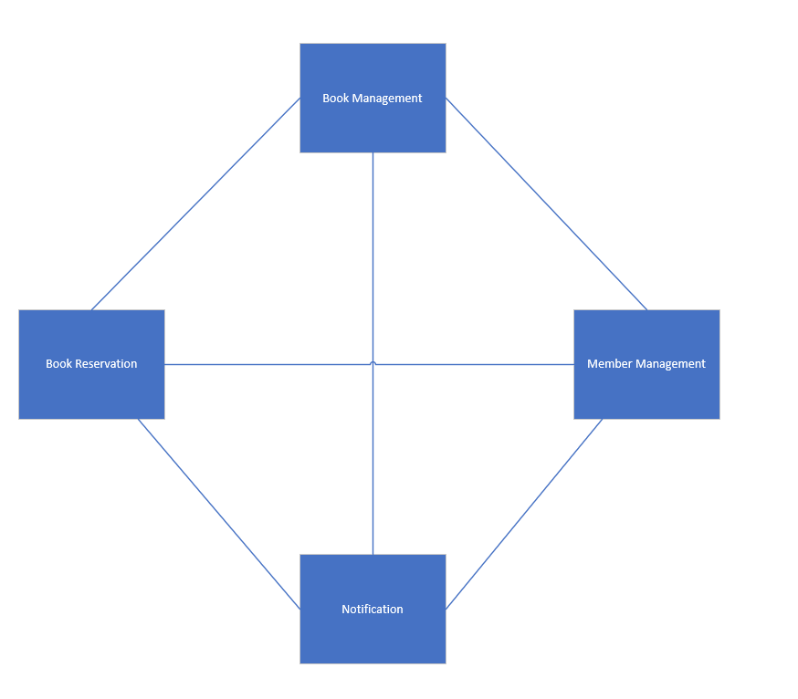
A Mundane Example
Generally managed by an orchestrator
Tight coupling between services
Each service contains a piece of knowledge about other service
Makes application difficult to expand
Application gets brittle as the dependencies increase with modules

Slide 5
I walk into the room.
Flip on the light switch so that lights come on
vs
I walked in to room.
Lights came on.
Source: https://www.confluent.io/blog/journey-to-event-driven-part-1-why-event-first-thinking-changes-everything/

Slide 6
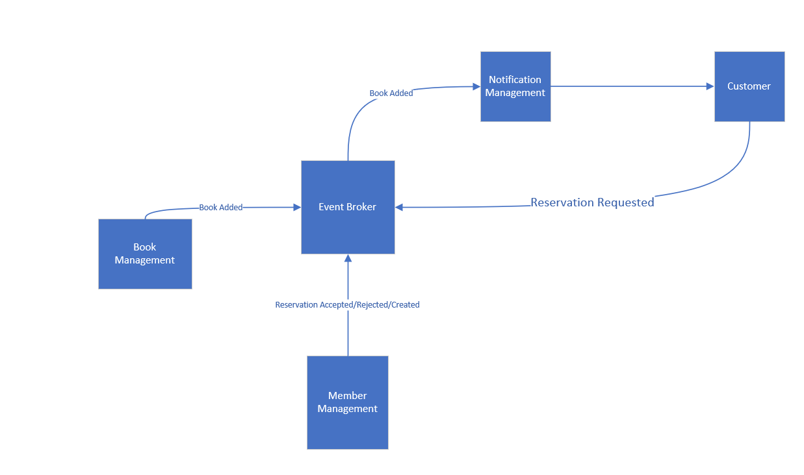

Slide 7
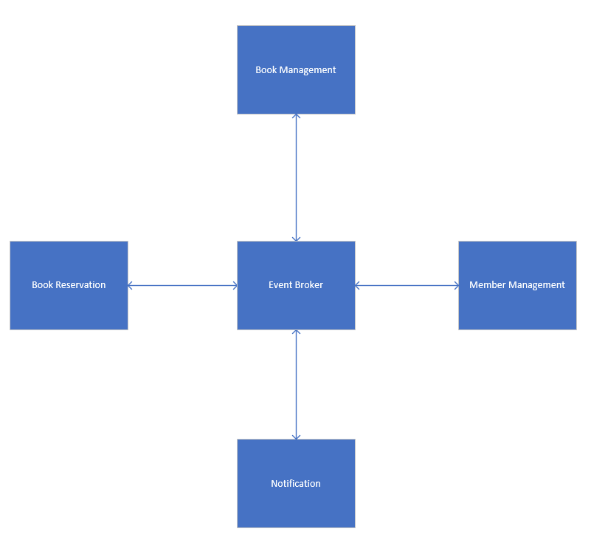
Reversal of Dependencies
Each system pushes their own events to the broker
The interested subscribers pick up messages
Creates loosely coupled system
Dependencies are inverted

Slide 8
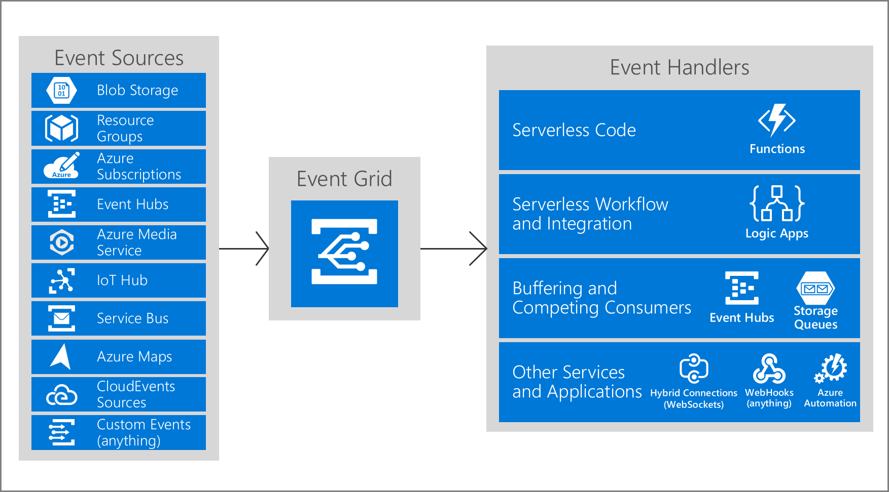
Azure Event Grid
Helps build event driven solutions using Pub-Sub Model- Push Not Poll
Sub second end to end latency in 99th Percentile
10000000 events per sec pre region
Supports Built In as Well as Custom Events
Has a very High Throughput
Pay Per Event Billing Model
Fairly cheap

Slide 9

Azure Functions
Serverless Compute Service
Has plethora of triggers and bindings to integrate with various Azure Services
Developer Oriented
Supports Local Debugging and Testing
Supports containerizations and production slots
Can be run on fixed price App Service Plans or Consumption Based plans

Slide 10
Demo

Slide 11

Challenges
Traceability
Transactional consistency
Extra scaffolding required

Slide 12


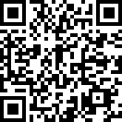
Repository
https://bit.ly/2YiyPq4

Slide 13
Reading Resources
https://www.confluent.io/blog/journey-to-event-driven-part-1-why-event-first-thinking-changes-everything/
https://www.youtube.com/watch?v=STKCRSUsyP0
https://azure.microsoft.com/en-us/blog/events-data-points-and-messages-choosing-the-right-azure-messaging-service-for-your-data/
https://docs.microsoft.com/en-us/azure/event-grid/
https://docs.microsoft.com/en-us/azure/azure-functions/

Slide 14
